Slide 1

Statistical analysis using Excel’s functions

Slide 2

Statistical analysis
Statistical analysis in Excel is a powerful way to analyze and interpret data. Excel offers various built-in statistical tools that can help perform a wide range of analyses. Its accessible interface and robust capabilities make it ideal for beginners and intermediate users who need to analyze and interpret data quickly and accurately without specialized statistical software.

Slide 3
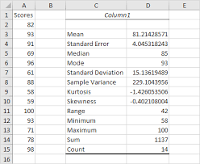
Tools used for statistical analysis in Excel
1. Descriptive Statistics
This includes measures such as mean, median, mode, standard deviation, variance, and range. You can quickly calculate these using built-in functions or the Data Analysis Toolpak.
Key Functions:
AVERAGE() - for mean
MEDIAN() – for median
MODE.SNGL() – for mode
STDEV.P() or STDEV.S() – for standard deviation (population or sample)
VAR.P() or VAR.S() – for variance (population or sample)

Slide 4
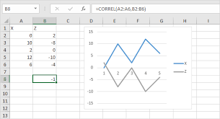
2. Correlation and Covariance
These help understand the relationships between two datasets.
Steps: In the Data Analysis Toolpak, choose Correlation or Covariance.
Select the data ranges for your variables and get the output.
Key Functions:
CORREL(array1, array2) – for correlation
COVARIANCE.P() or COVARIANCE.S() – for covariance

Slide 5
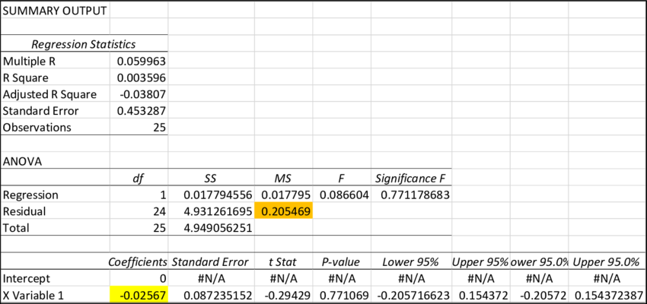
3. Regression Analysis
Regression helps you model relationships between dependent and independent variables
Steps: In Data Analysis Toolpak, select Regression.
Define the Input Y Range (dependent variable) and Input X Range (independent variable).
Choose the output options and interpret the results, including coefficients, R-squared values, and residuals.
Key Function:
LINEST() – for linear regression

Slide 6
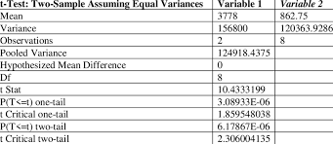
4. Hypothesis Testing
Excel can be used for various hypothesis tests, including t-tests, z-tests, and ANOVA.
Steps:
In the Data Analysis Toolpak, select the appropriate test (e.g., t-Test: Paired Two Sample for Means).
Key Functions:
T.TEST() – for t-test
Z.TEST() – for z-test
CHISQ.TEST() – for chi-squared test
ANOVA (via Data Analysis Toolpak)

Slide 7
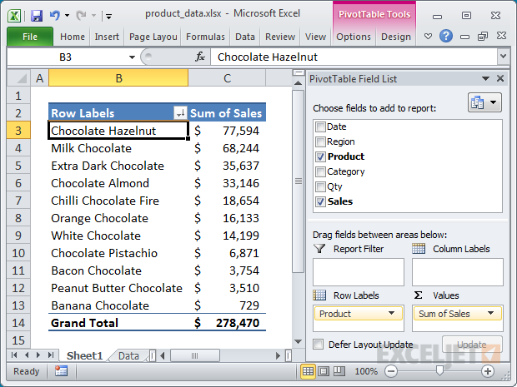
5. Pivot Tables for Summarization
Pivot tables help summarize large datasets and perform custom calculations like sums, averages, and counts, which are crucial in analyzing trends and patterns.
Steps:
Go to the Insert tab, select Pivot Table, and choose your data range.
Drag fields into the Rows, Columns, and Values areas to create a meaningful summary.

Slide 8
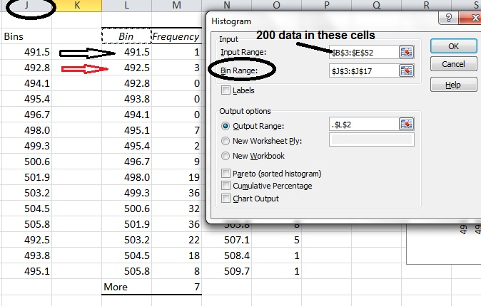
6. Histograms
Histograms allow you to visualize the distribution of data.
Steps: Go to the Data Analysis Toolpak and select Histogram.
Input the data range and specify the bin range to create the frequency distribution.
Key Function:
FREQUENCY() – for frequency distribution

Slide 9
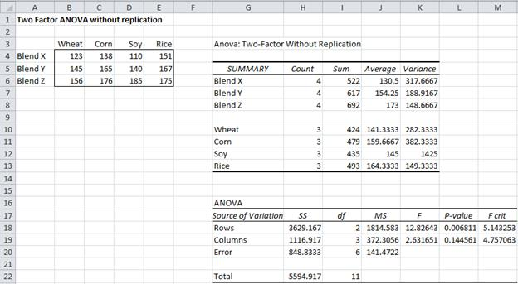
7. ANOVA (Analysis of Variance)
ANOVA helps to compare means across multiple groups.
Steps:
In Data Analysis Toolpak, choose ANOVA: Single Factor or ANOVA: Two Factor.
Define your data ranges and interpret the F-statistic and p-values.

Slide 10
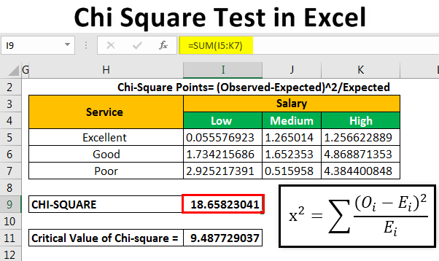
8. Chi-Square Test
This test helps to determine if there is a significant association between categorical variables.
Key Function:
CHISQ.TEST() – for testing independence between categorical variables.

Slide 11
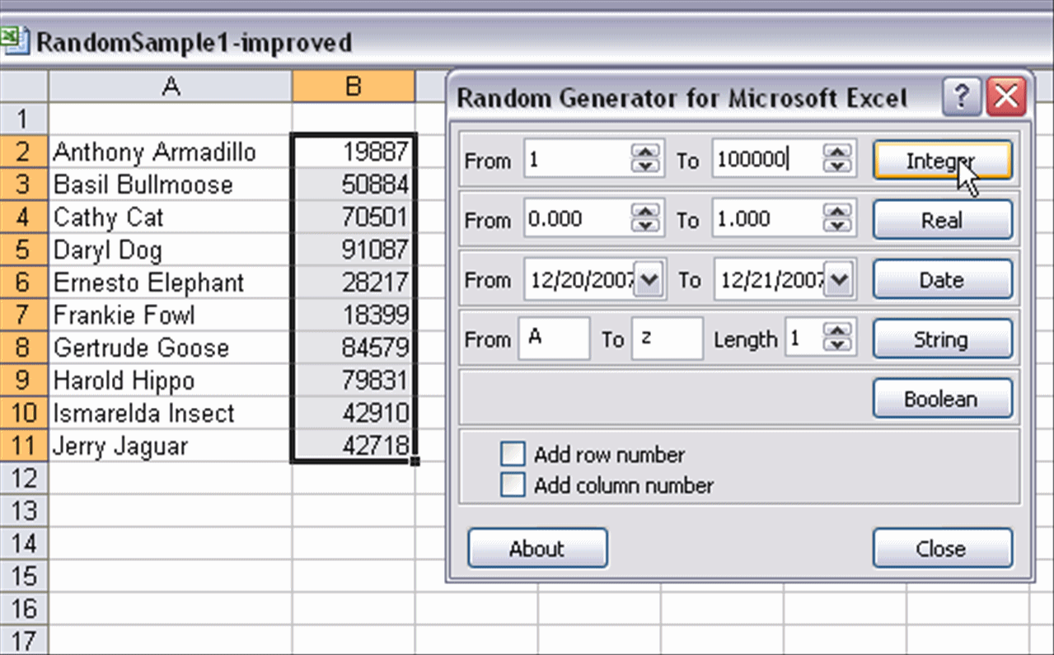
9. Random Sampling
Excel can be used to generate random samples for simulations or bootstrapping.
Key Function:
RAND() or RANDBETWEEN() – for random number generation.

Slide 12

Conclusion
The conclusion of statistical analysis in Excel highlights its effectiveness and versatility as a tool for performing a wide array of statistical techniques. Excel's built-in functions, along with the Data Analysis Toolpak, enable users to conduct everything from basic descriptive statistics to more complex analyses such as regression, hypothesis testing, and ANOVA.

Slide 13


Thank you
ajaycraju98@gmail.com

